Slide 1

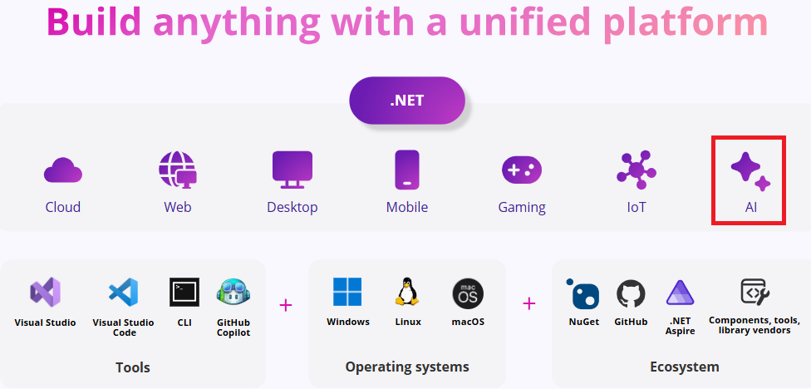
How to develop Intelligent Applications with .NET 9
Author: Luis Coco Enríquez

Slide 2







Personal profile
Senior .Net Software Engineer
AI services, Aspire .NET 9, Blazor, MAUI-Blazor Azure, AWS, Google Cloud Services
https://www.linkedin.com/in/luis-coco-enriquez-44a28a29/

Slide 3




Agenda
Topic
ChatGPT and ChatGPT APIs
OpenAI for .NET
Azure OpenAI and Azure.AI.OpenAI library
Semantic Kernel
Microsoft.Extensions.AI

Slide 4
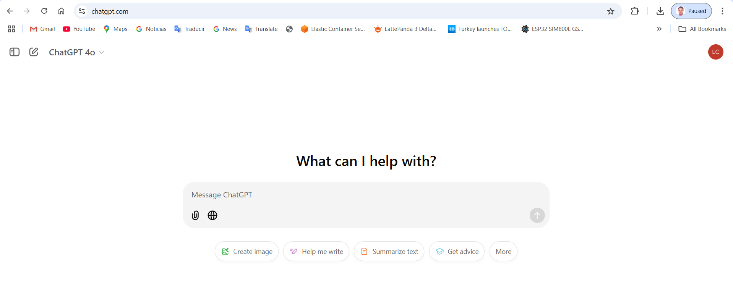
What is ChatGPT?
https://en.wikipedia.org/wiki/ChatGPT
ChatGPT is a Generative Artificial Intelligence (AI) chatbot developed by OpenAI and launched in November 2022
ChatGPT can generate human-like conversational responses
ChatGPT is built on OpenAI's proprietary series of Generative Pre-trained Transformer (GPT) Large Language Models (LLMs), and is fine-tuned for conversational applications using a combination of supervised learning and reinforcement learning from human feedback. Successive user prompts and replies are considered at each conversation stage as context
https://chatgpt.com/

Slide 5
What is GPT (Generative Pre-Trained Transformer)?
A generative pre-trained transformer (GPT) is a type of large language model (LLM) and a prominent framework for generative artificial intelligence.
It is an Artificial Neural Network that is used in natural language processing by machines.
It is based on the Transformer Deep Learning Architecture, pre-trained on large data sets of unlabeled text, and able to generate novel human-like content.
As of 2023, most LLMs had these characteristics and are sometimes referred to broadly as GPTs.
https://en.wikipedia.org/wiki/Generative_pre-trained_transformer

Slide 6
What is aTransformer (Deep Learning Architecture)?
A Transformer is a deep learning architecture developed by researchers at Google and based on the multi-head attention mechanism, proposed in the 2017 paper "Attention Is All You Need".
Text is converted to numerical representations called tokens.
Each token is converted into a vector via lookup from a word embedding table.
At each layer, each token is then contextualized within the scope of the context window with other (unmasked) tokens via a parallel multi-head attention mechanism, allowing the signal for key tokens to be amplified and less important tokens to be diminished.
https://en.wikipedia.org/wiki/Transformer_(deep_learning_architecture)

Slide 7
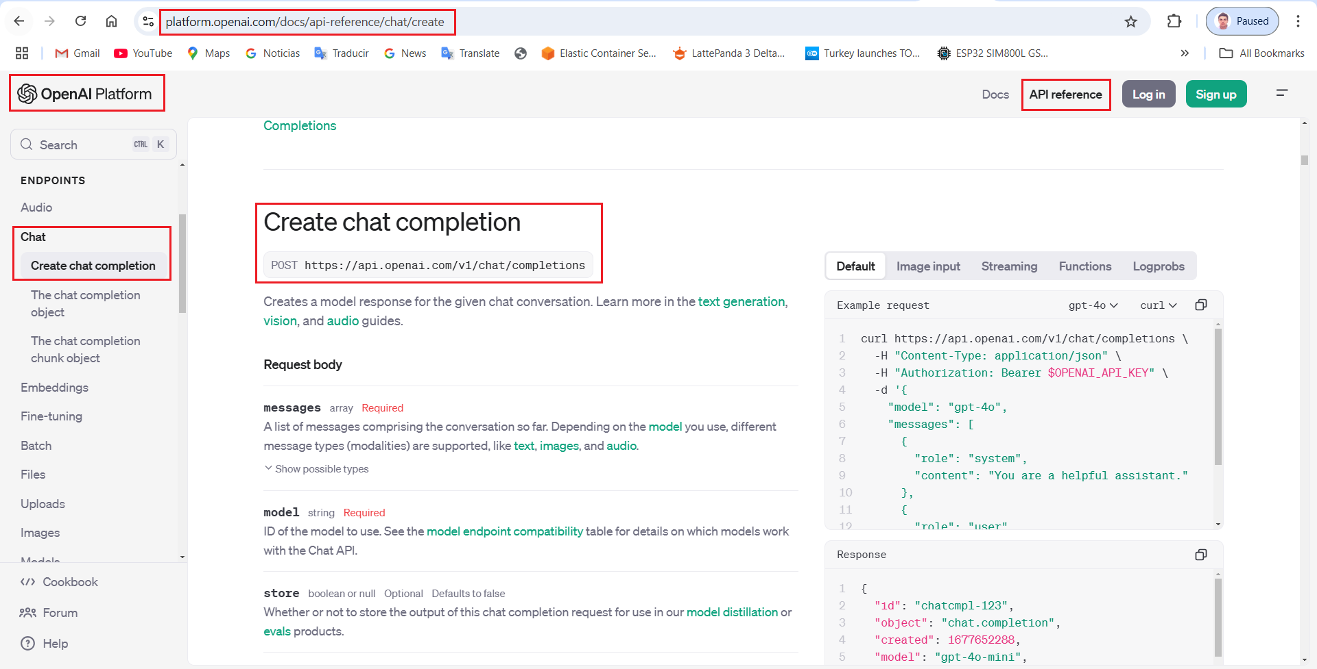
What is ChatGPT OpenAI API?
https://platform.openai.com/docs/api-reference

Slide 8
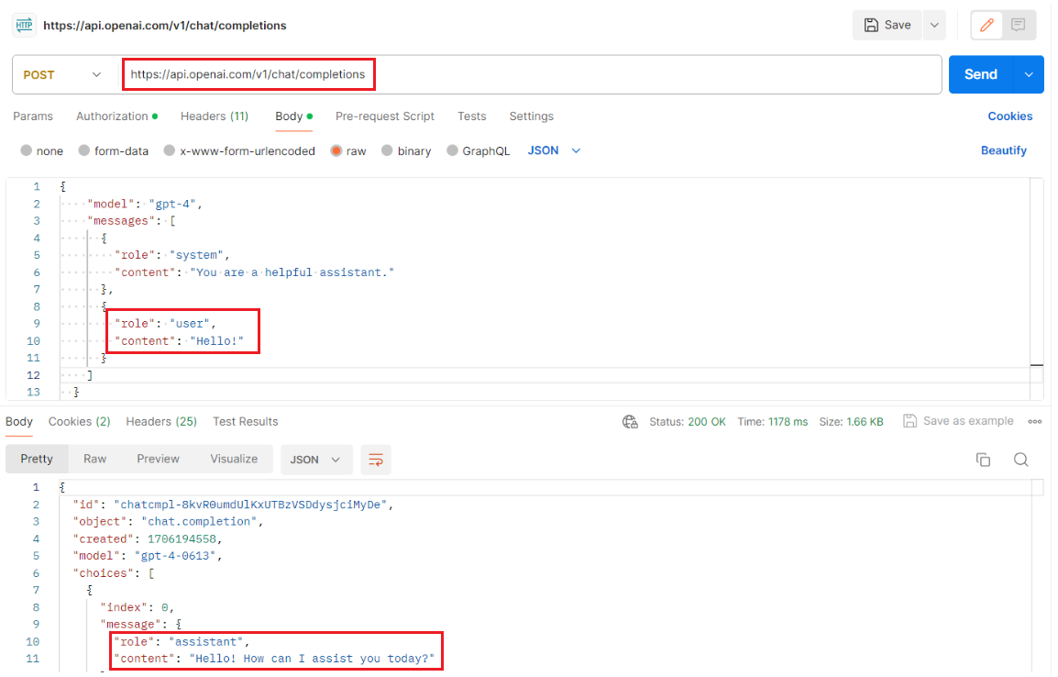
What is ChatGPT OpenAI API?
//Set the authorization header with the API key
_httpClient.DefaultRequestHeaders
.Add("Authorization", $"Bearer {apiKey}");
//Make the POST request using the configured HttpClient var response =
await _httpClient.PostAsync(apiUrl, requestContent);
https://github.com/luiscoco/ChatGPT_OpenAI-Sample1-QuickStart
https://github.com/luiscoco/ChatGPT_OpenAI-Sample2-ChatGPT-WebAPI

Slide 9

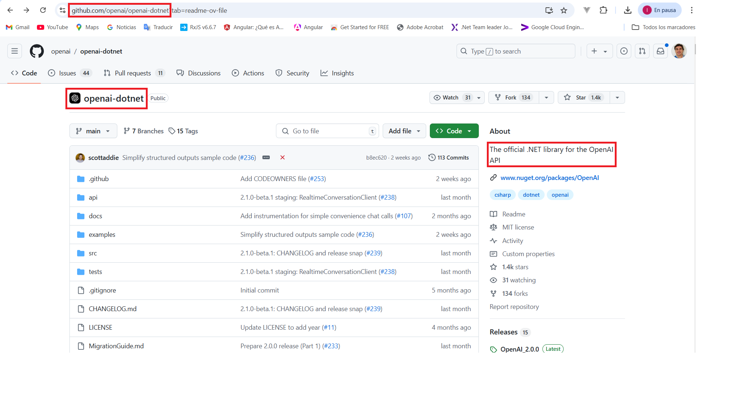
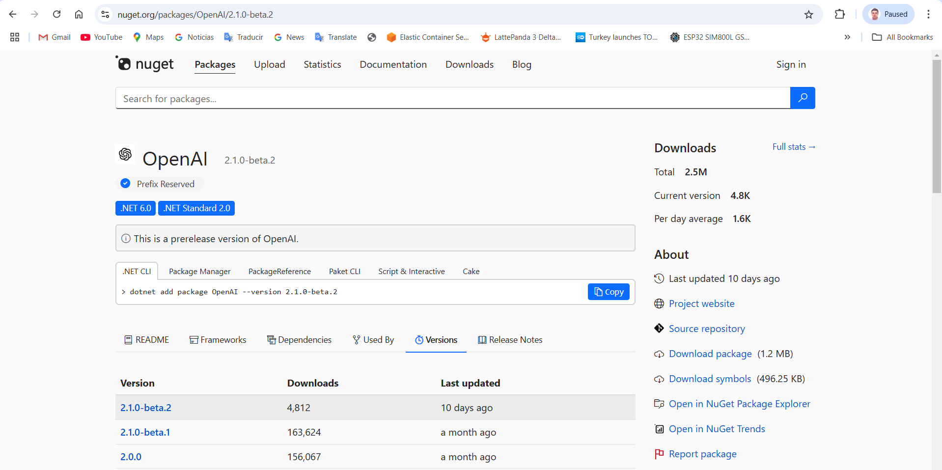
OpenAI for .NET
The official .NET library for the OpenAI API
https://github.com/openai/openai-dotnet
https://www.nuget.org/packages/OpenAI
https://github.com/openai/openai-openapi/blob/master/openapi.yaml

Slide 10
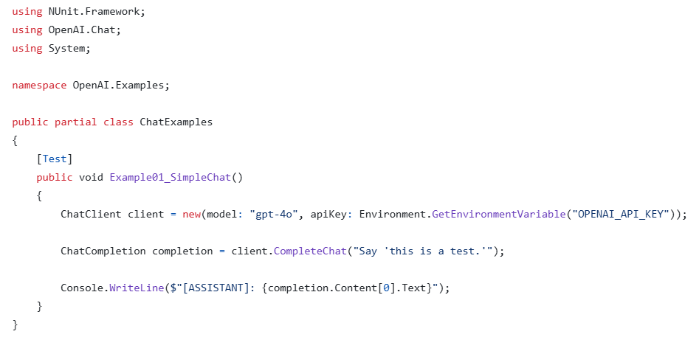
OpenAI for .NET
The official .NET library for the OpenAI API

Slide 11

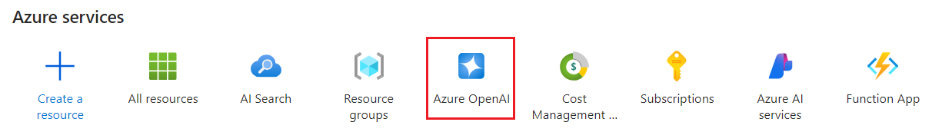
What is Azure OpenAI?
Azure OpenAI Service provides REST API access to OpenAI's powerful LLMs Large Language Models including o1-preview, o1-mini, GPT-4o, GPT-4o mini, GPT-4 Turbo with Vision, GPT-4, GPT-3.5-Turbo, and Embeddings model series.
These models can be easily adapted to your specific task including but not limited to content generation, summarization, image understanding, semantic search, and natural language to code translation. Users can access the service through REST APIs, Python or C# SDK, or in the Azure AI Studio.
https://learn.microsoft.com/en-us/azure/ai-services/openai

Slide 12
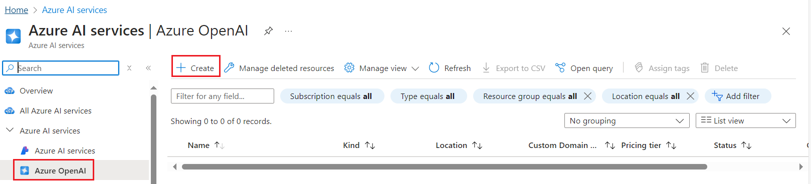
Azure OpenAI: How to provision in Azure Portal
https://github.com/luiscoco/Azure_OpenAI_How-to-deploy-GPT-4o

Slide 13
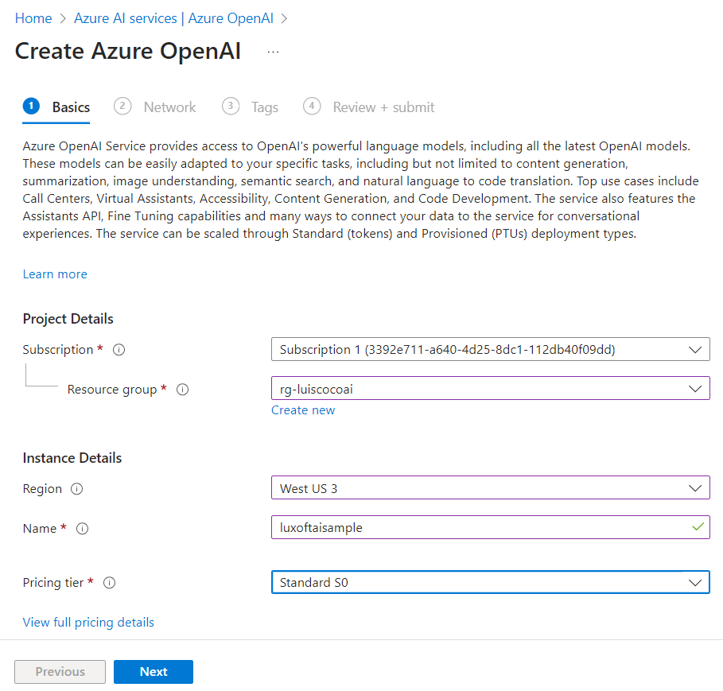
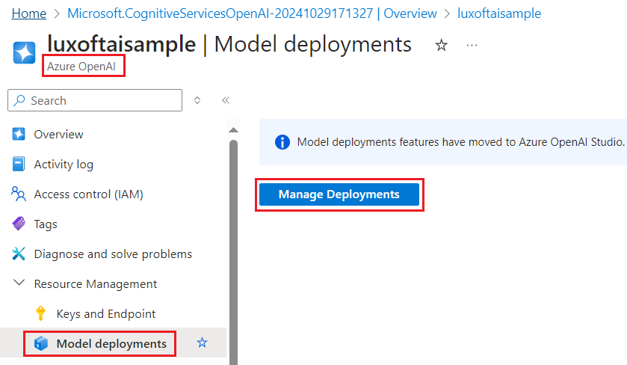
Azure OpenAI: How to provision in Azure Portal
https://github.com/luiscoco/Azure_OpenAI_How-to-deploy-GPT-4o

Slide 14
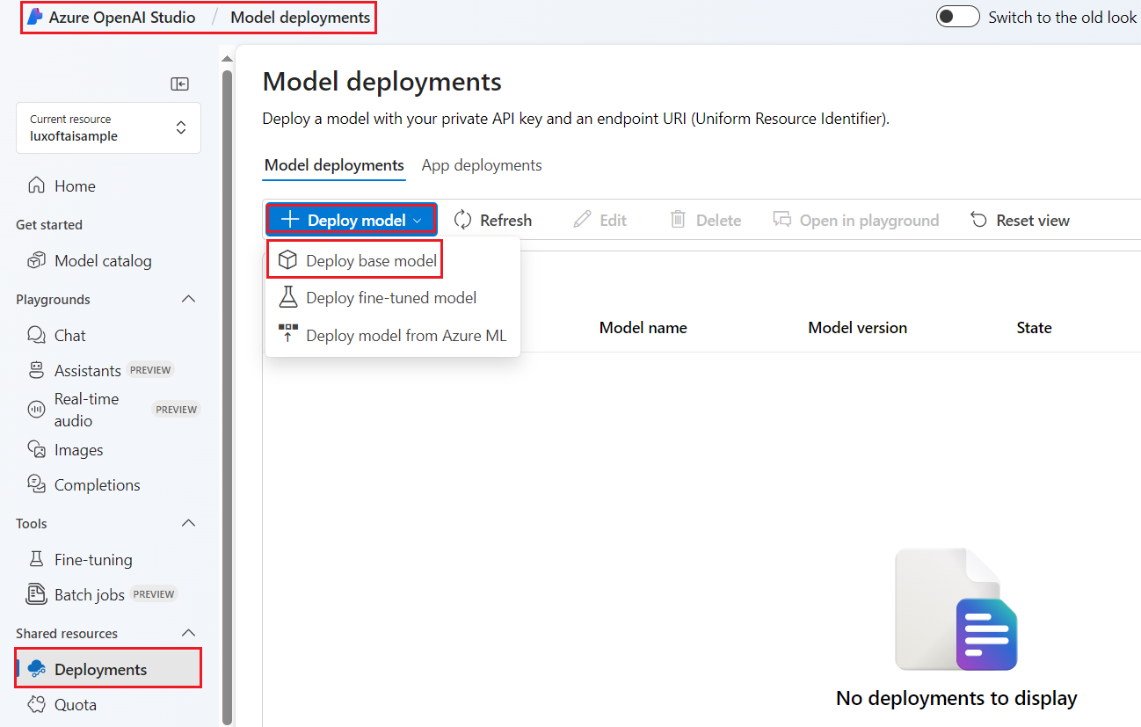
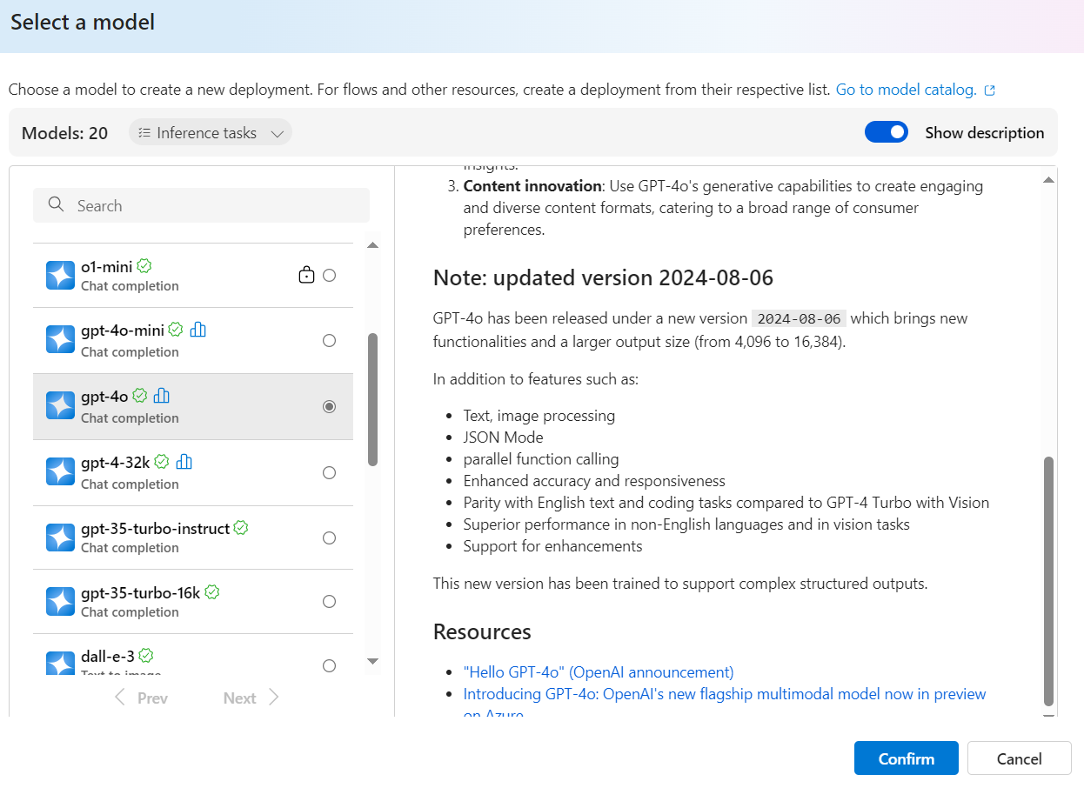
Azure OpenAI: How to provision in Azure Portal
https://github.com/luiscoco/Azure_OpenAI_How-to-deploy-GPT-4o

Slide 15
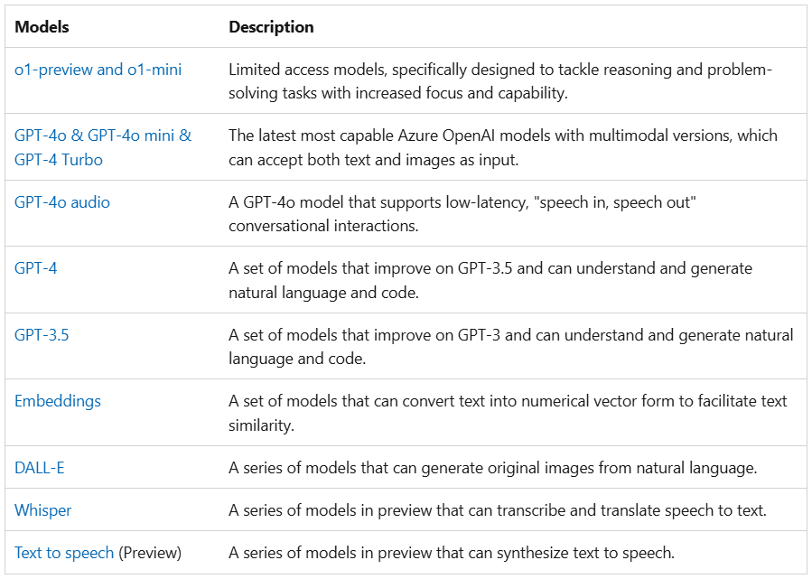
Azure OpenAI Service models
https://learn.microsoft.com/en-us/azure/ai-services/openai/concepts/models

Slide 16
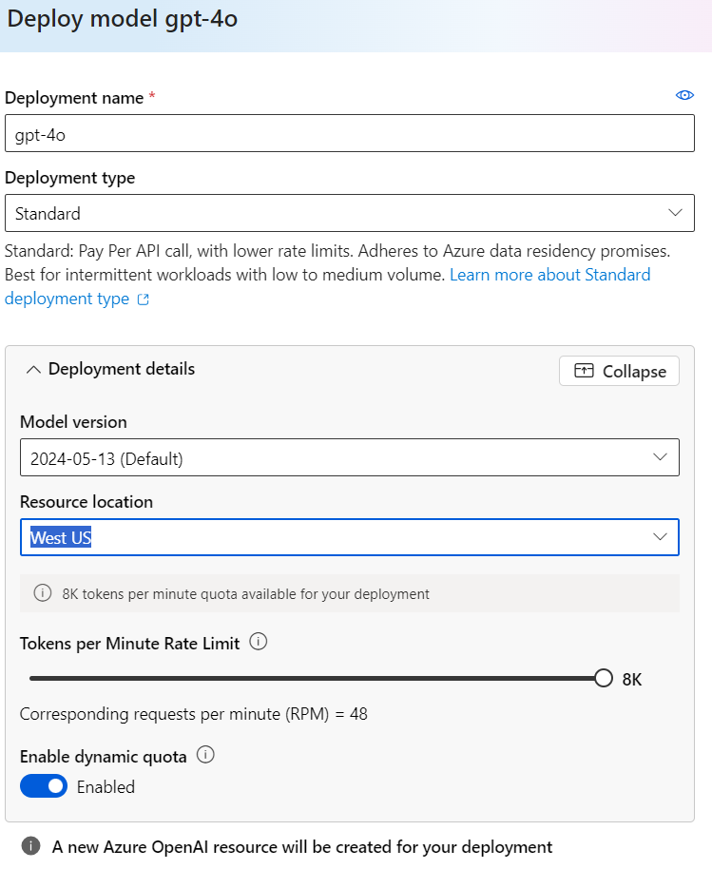
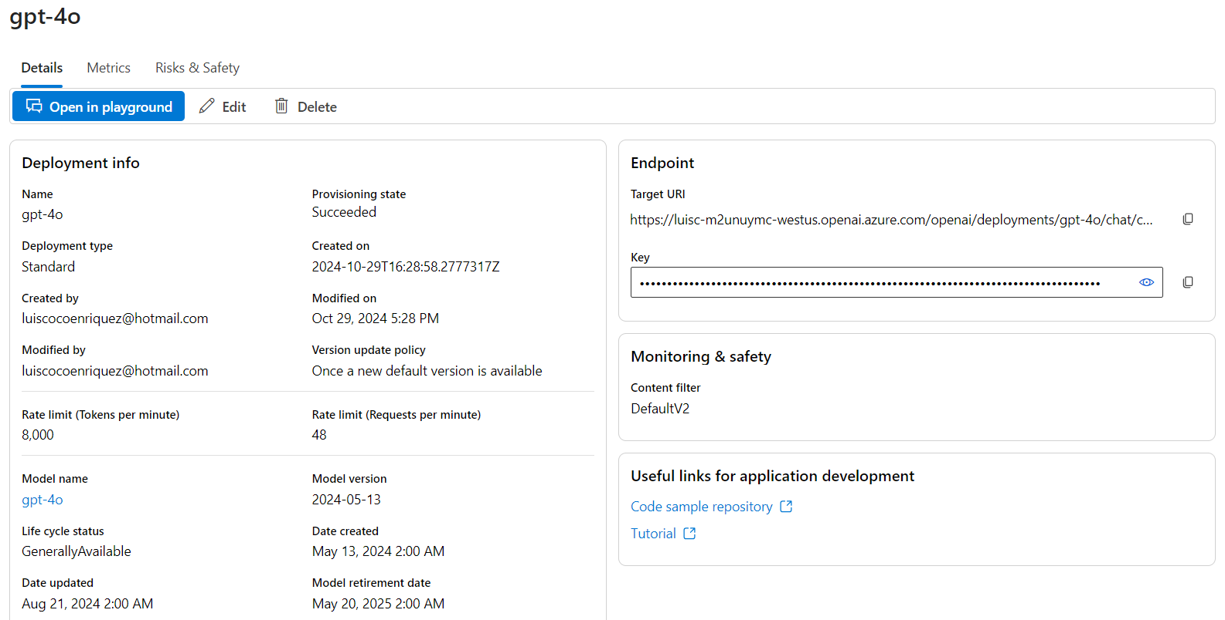
Azure OpenAI: How to provision in Azure Portal
https://github.com/luiscoco/Azure_OpenAI_How-to-deploy-GPT-4o

Slide 17
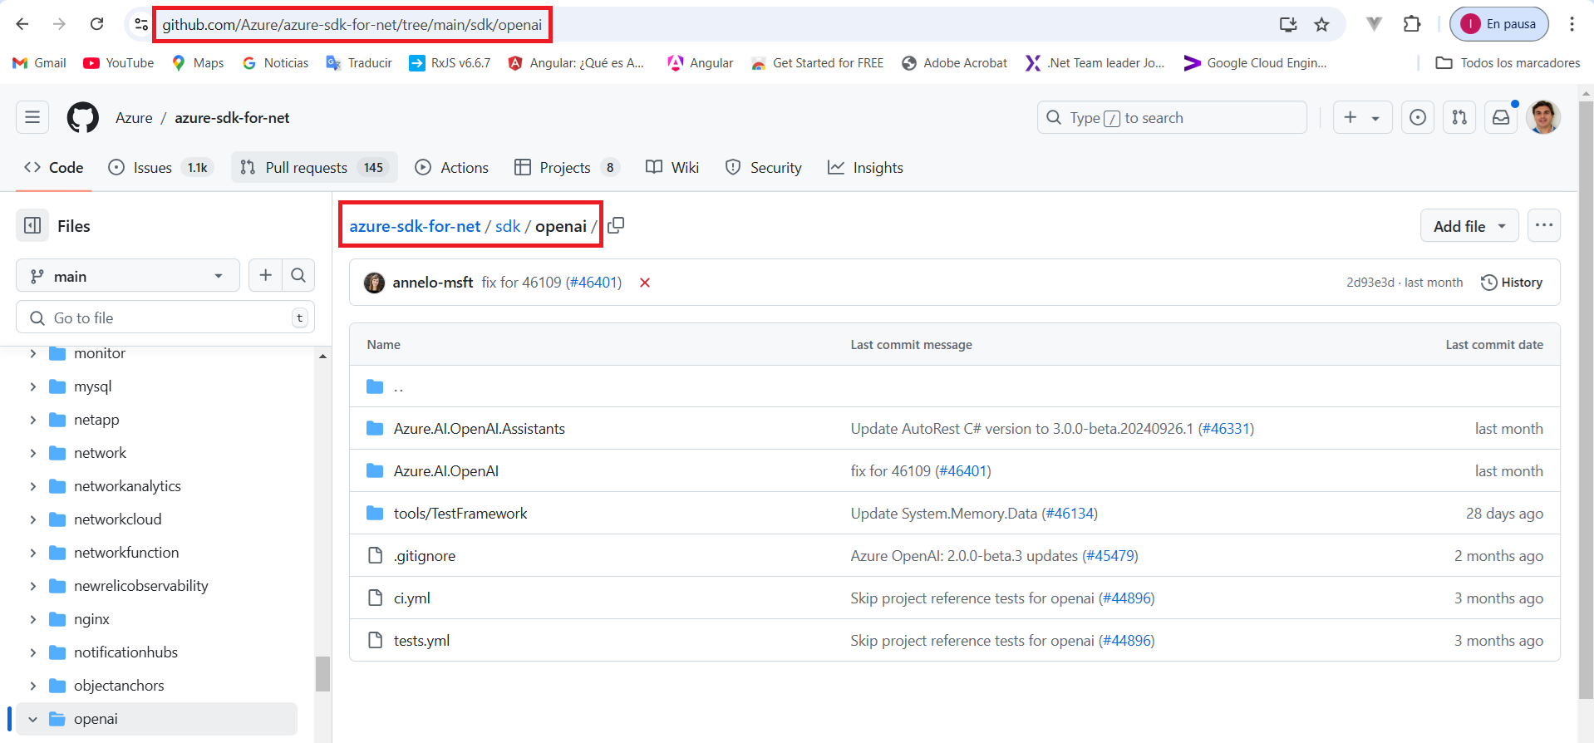
Azure OpenAI Nuget Packages
https://github.com/Azure/azure-sdk-for-net/tree/main/sdk/openai
https://www.nuget.org/packages/Azure.AI.OpenAI/2.1.0-beta.1
https://www.nuget.org/packages/Azure.AI.OpenAI.Assistants/1.0.0-beta.4
https://www.nuget.org/packages/Aspire.Azure.AI.OpenAI/9.0.0-preview.4.24511.1
https://www.nuget.org/packages/Aspire.Hosting.Azure.CognitiveServices/9.0.0-rc.1.24511.1

Slide 18
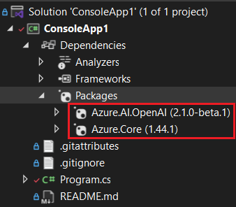
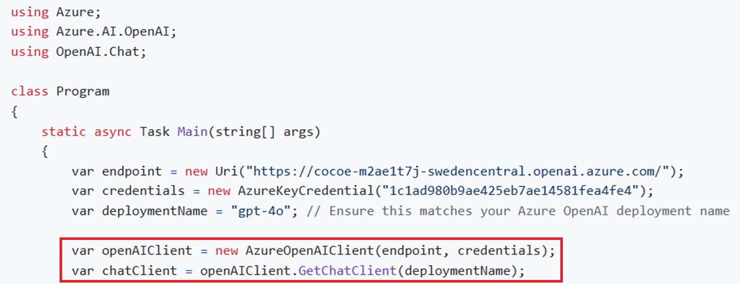
Azure OpenAI: How to provision the service with C# SDK
AzureOpenAIClient (Endpoint, Key)
GetChatClient (DeploymentName)

Slide 19
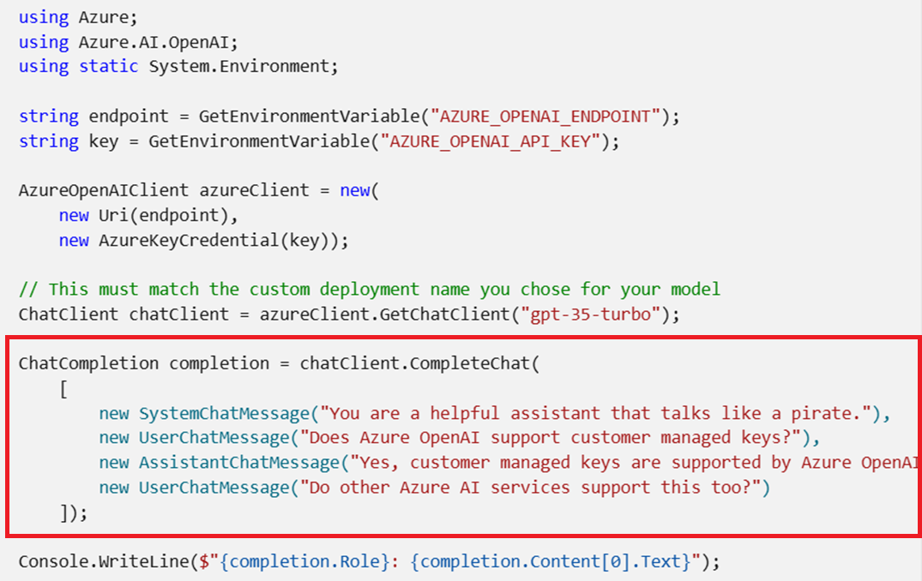
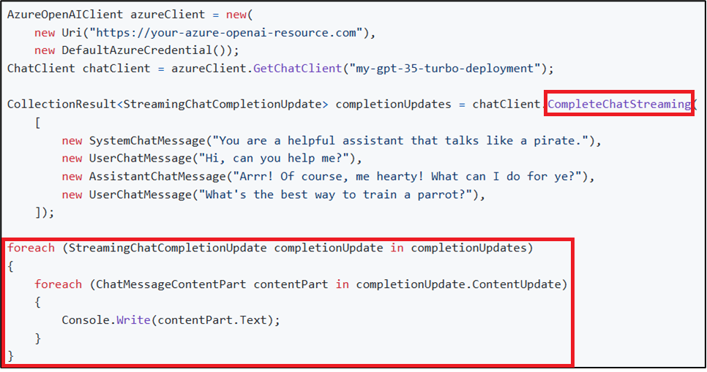
Azure OpenAI: ChatCompletion with gpt-4o model
AI Completion Service: You input some text as a prompt. The model generates the completion and attempts to match your context or pattern. Suppose you provide the prompt "As Descartes said, I think, therefore" to the API. For this prompt, Azure OpenAI returns the completion endpoint " I am" with high probability.

Slide 20
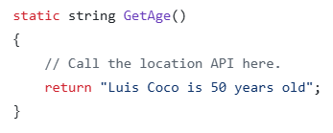
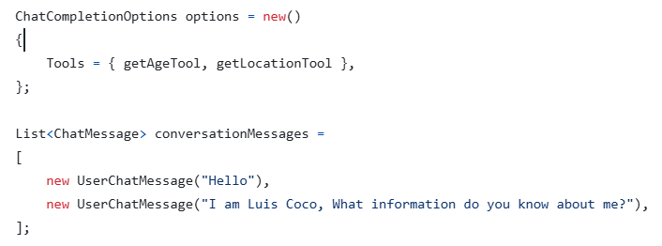
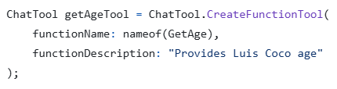
Azure OpenAI: Use Chat Tools (call Functions)
Tools extend chat completions by allowing an assistant to invoke defined functions and other capabilities in the process of fulfilling a chat completions request. To use chat tools, start by defining a function tool.
Function definition
Chat Options definition
Tool definition
ChatCompletion completion = chatClient.CompleteChat(conversationMessages,options);
https://github.com/luiscoco/Azure_OpenAI-Use_Chat_Tools-Function_Call
https://github.com/luiscoco/Azure_OpenAI-Use_Chat_Tools-Function_Call-version2

Slide 21
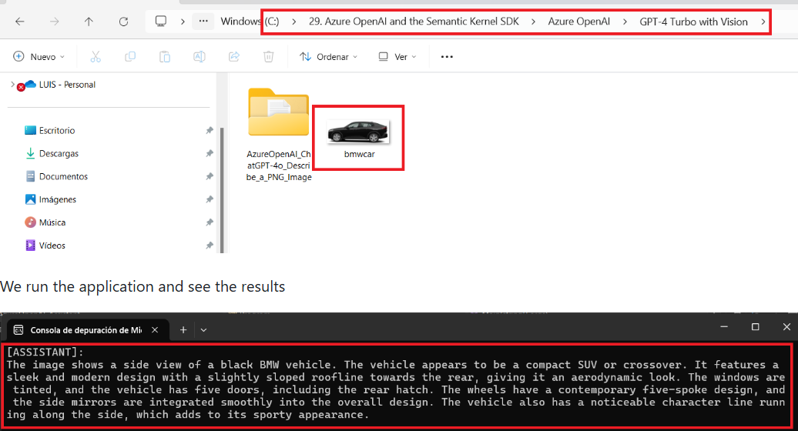
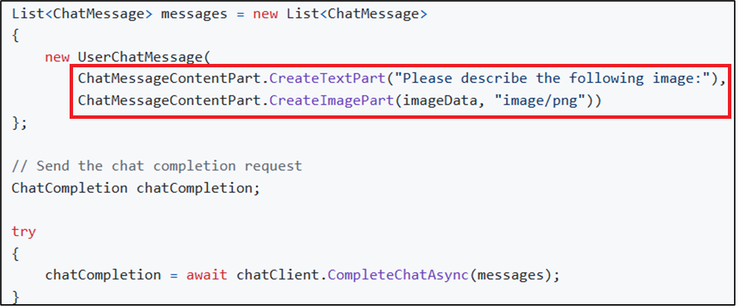
Azure OpenAI: Describe and Image with gpt-4o model
We can provide an image in the prompt when invoking the gpt-4o model with the CompleteChat function
https://github.com/luiscoco/Azure_OpenAI_GPT-4o-How_to_descritbe_an_Image

Slide 22
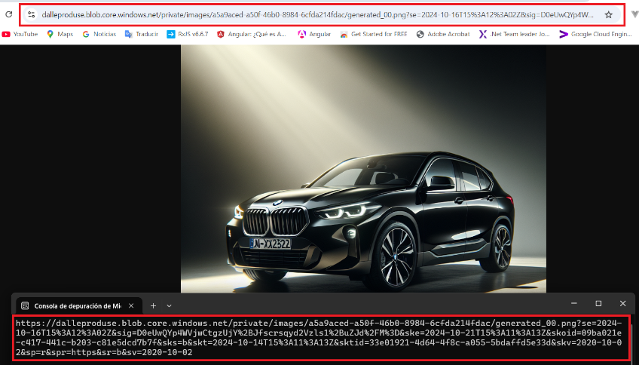
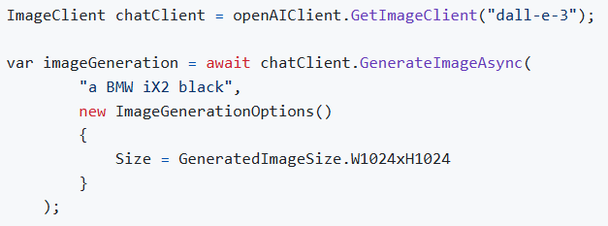
Azure OpenAI: Create an Image with DALL-E model
OpenAI's DALL-E models generate images based on user-provided text prompts
https://github.com/luiscoco/Azure_OpenAI-DALL_E_3-How_to_create_an_image

Slide 23
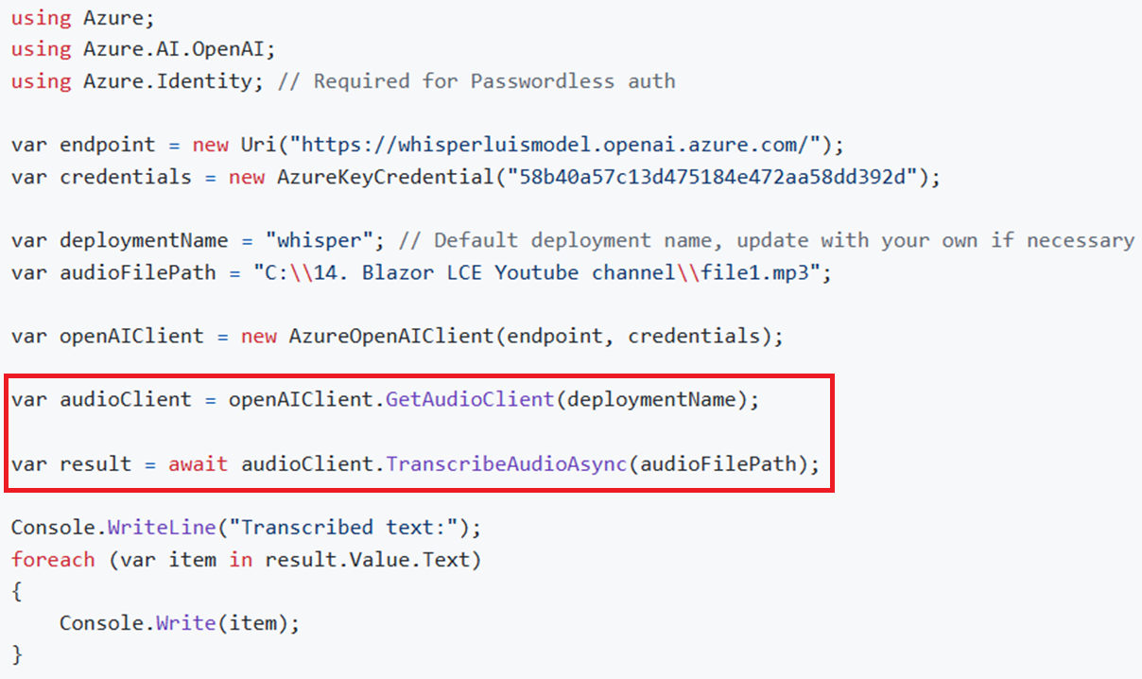
Azure OpenAI: Speech to Text with Whisper model
The Whisper model can transcribe human speech in numerous languages, and it can also translate other languages into English.
https://github.com/luiscoco/Azure_OpenAI-WhisperModel-Read_a_Text

Slide 24
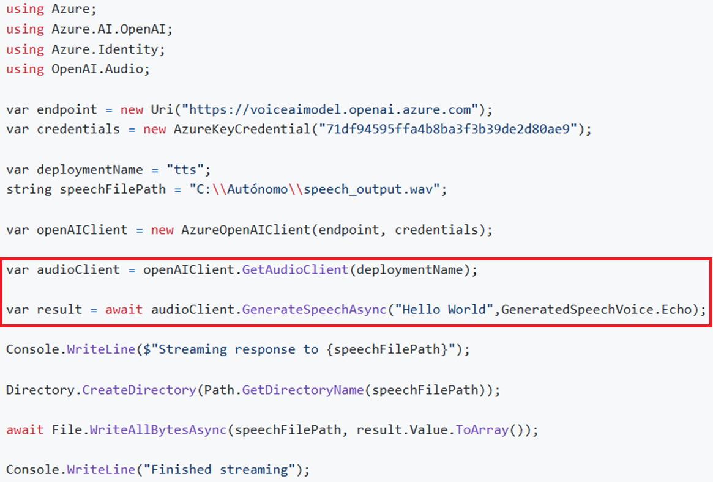
Azure OpenAI: Read a Text with tts model
https://github.com/luiscoco/Azure_OpenAI-tts-TextToSpeech

Slide 25
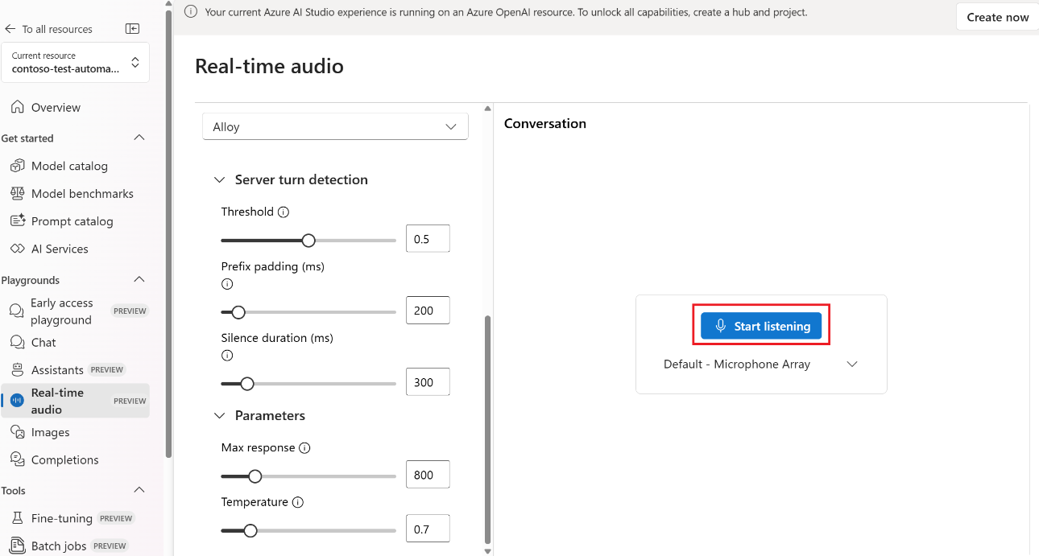
Azure OpenAI: Realtime Speech with gpt-4o-realtime-preview model
https://learn.microsoft.com/en-us/azure/ai-services/openai/realtime-audio-quickstart

Slide 26

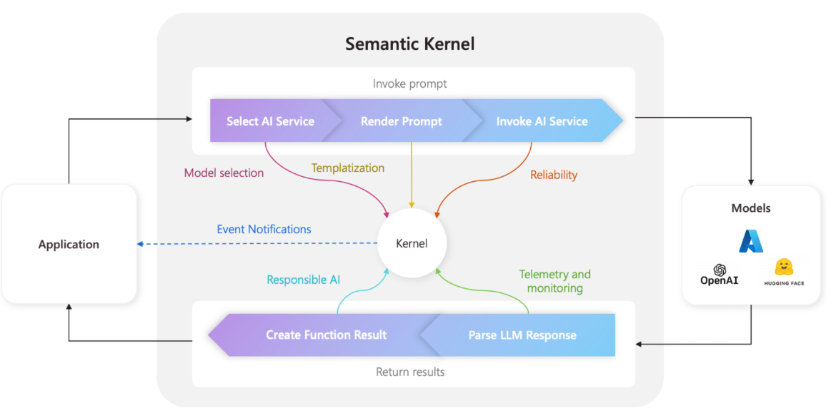
What is Microsoft Semantic Kernel?
Semantic Kernel (SK) is a lightweight SDK enabling integration of AI Large Language Models (LLMs) with conventional programming languages.
The SK extensible programming model combines natural language semantic functions, traditional code native functions, and embeddings-based memory unlocking new potential and adding value to applications with AI
https://github.com/microsoft/semantic-kernel

Slide 27
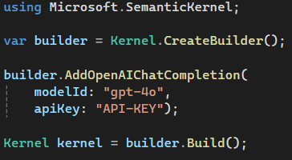
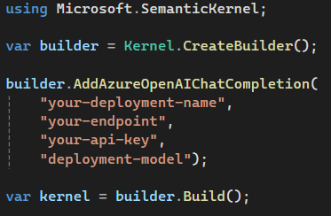
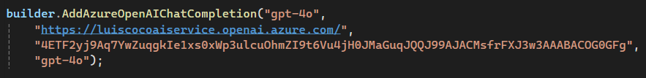
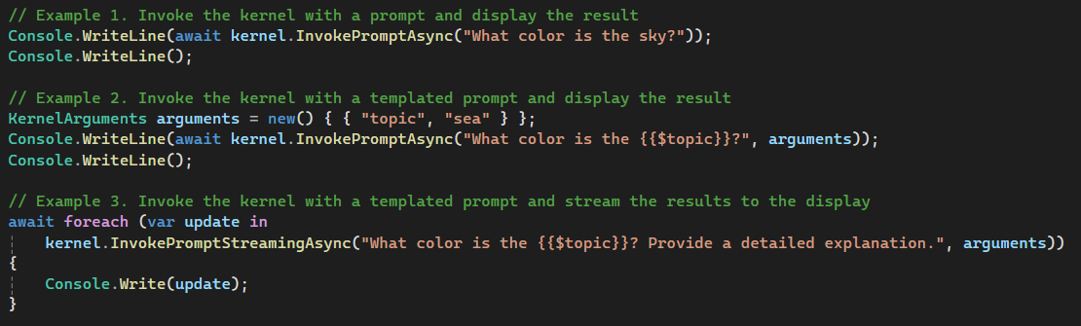
Semantic Kernel: build Kernel and invoke ChatCompletion
OpenAI service
Azure OpenAI service
https://platform.openai.com/api-keys
https://github.com/luiscoco/Curso_Aprende_Blazor-MicrosoftSemanticKernel-GetStart

Slide 28
Semantic Kernel: Chatbot with Ollama
using Microsoft.SemanticKernel;
using System;
using System.ClientModel.Primitives;
var endpoint = new Uri("http://localhost:11434");
var modelId = "phi3:latest";
#pragma warning disable SKEXP0010
var kernelBuilder = Kernel.CreateBuilder()
.AddVolatileVectorStore()
.AddOpenAIChatCompletion(modelId: modelId, apiKey: null, endpoint: endpoint);
#pragma warning restore SKEXP0010
var kernel = kernelBuilder.Build();
const string skPrompt = @"
JamicanFoodBot can give you recommendations on Jamaican Food cuisine and recipes.
It can give explicit instructions on how to cook these dishes. It will provide you ingredients, measurements, and cook time.
{{ $history }}
User: {{ $userInput }}
JamicanFoodBot:";
var chatFunction = kernel.CreateFunctionFromPrompt(skPrompt);
var history = "";
var arguments = new KernelArguments
{
["history"] = history
};
while (true)
{
Console.Write("Tell me what kind of food you are in the mood for: ");
var userInput = Console.ReadLine();
if (userInput.Equals("quit", StringComparison.OrdinalIgnoreCase))
{
Console.WriteLine("Goodbye!");
break;
}
arguments["userInput"] = userInput;
Console.Write("JamaicanFoodBot: ");
await foreach (var chunk in kernel.InvokeStreamingAsync(chatFunction, arguments))
{
Console.Write(chunk);
history += chunk;
}
history += $"\nUser: {userInput}\n";
arguments["history"] = history;
Console.WriteLine();
Console.WriteLine("Conversation history:");
Console.WriteLine(history);
}
https://github.com/luiscoco/Curso_Aprende_Blazor-MicrosoftSemanticKernel-Chatbot_Ollama

Slide 29
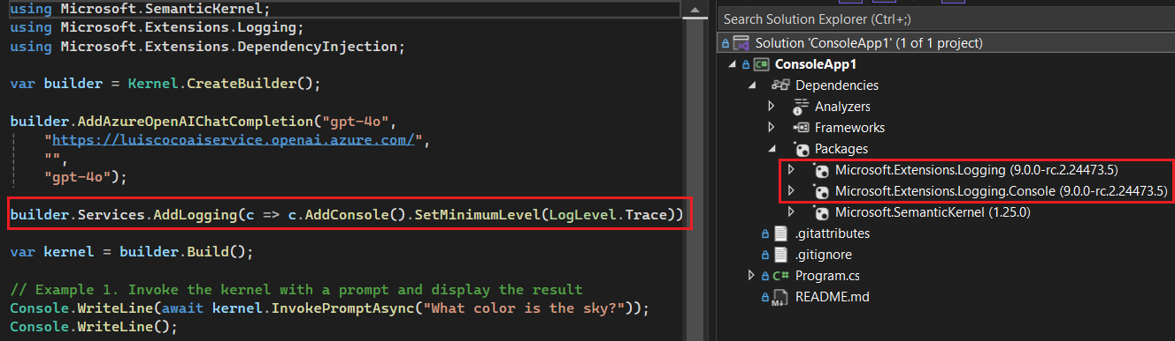
Semantic Kernel: Logging
Azure OpenAI service
https://github.com/luiscoco/Curso_Aprende_Blazor-MicrosoftSemanticKernel-Logging

Slide 30
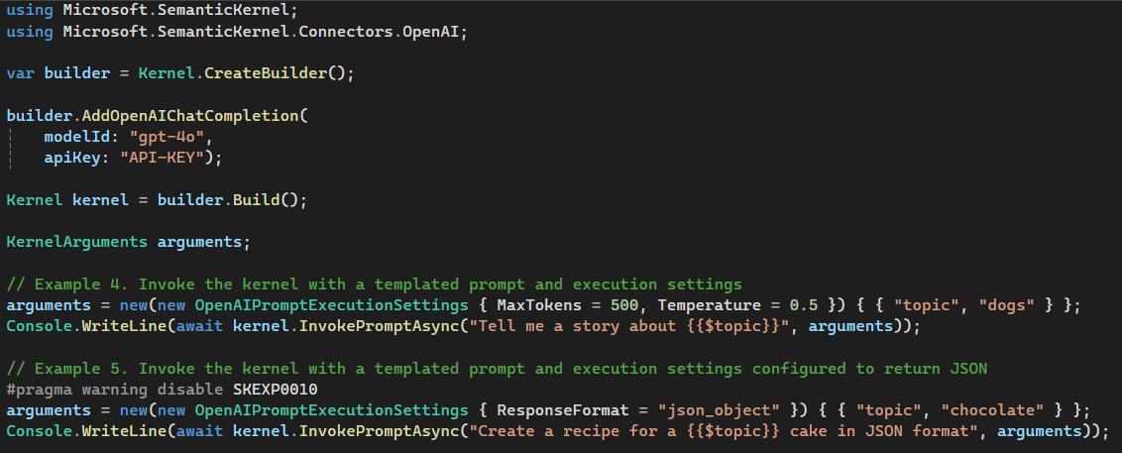
Semantic Kernel: Templated Prompt
https://github.com/luiscoco/Curso_Aprende_Blazor-MicrosoftSemanticKernel-GetStart

Slide 31
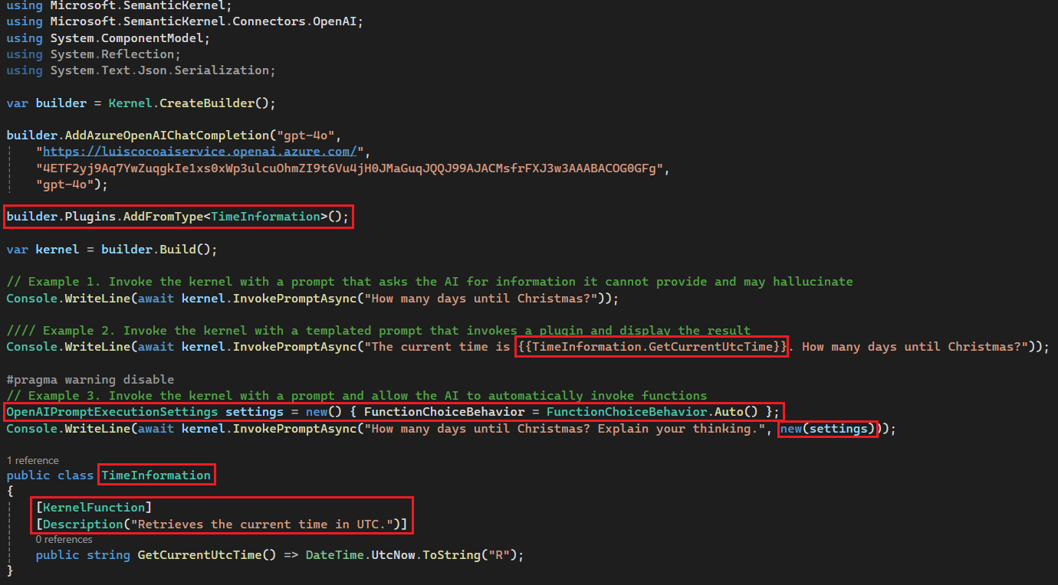
Semantic Kernel: Plugin
https://github.com/luiscoco/Curso_Aprende_Blazor-MicrosoftSemanticKernel-Plugin-Sample1

Slide 32
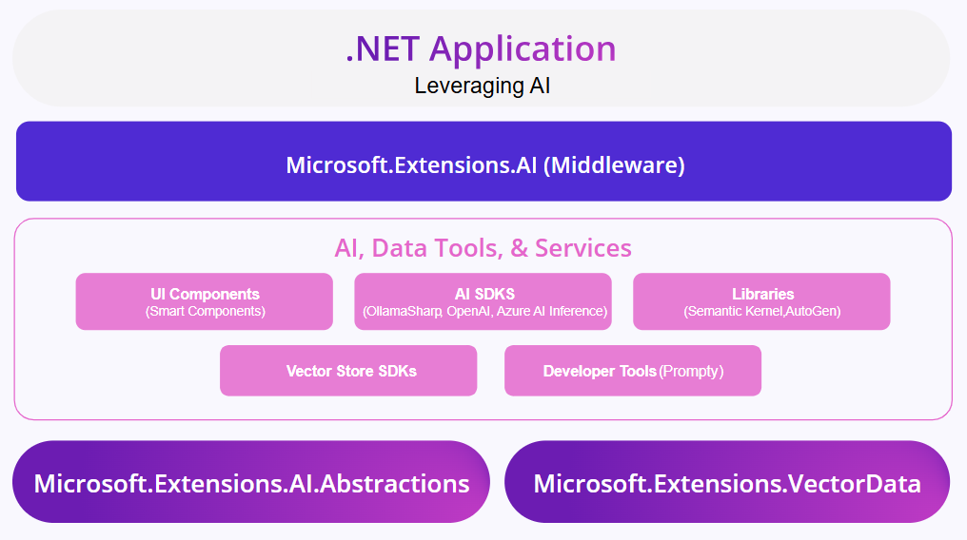
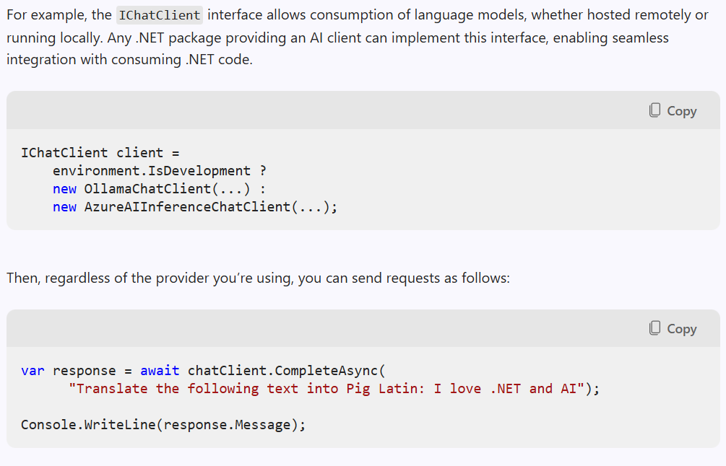
What is Microsoft.Extensions.AI?
These libraries provide a unified layer of C# common abstractions and standard middleware implementation for interacting with AI services
https://devblogs.microsoft.com/dotnet/introducing-microsoft-extensions-ai-preview

Slide 33
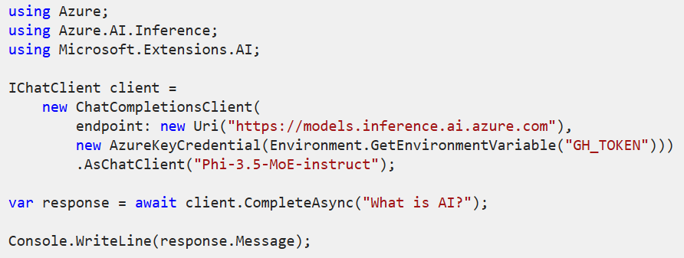
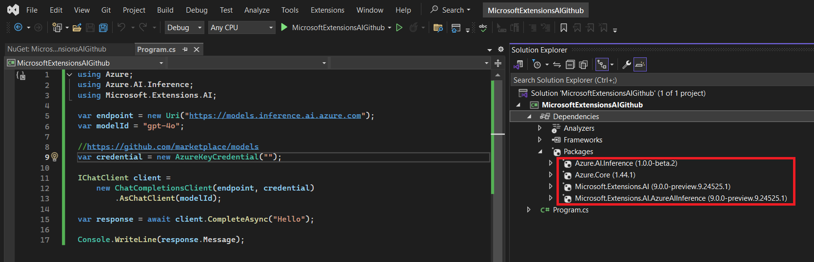
Microsoft.Extensions.AI: Azure AI Inference (Github Models)
Install the Microsoft.Extensions.AI.AzureAIInference NuGet package
https://github.com/luiscoco/microsoft-extensions-ai-github_ai_model
https://github.com/marketplace/models

Slide 34
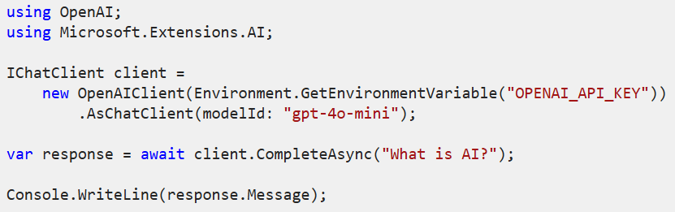
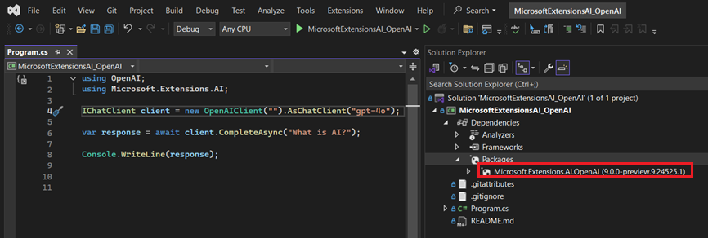
Microsoft.Extensions.AI: OpenAI
Install the Microsoft.Extensions.AI.OpenAI NuGet package
https://platform.openai.com/api-keys
https://github.com/luiscoco/microsoft-extensions-ai-OpenAI

Slide 35
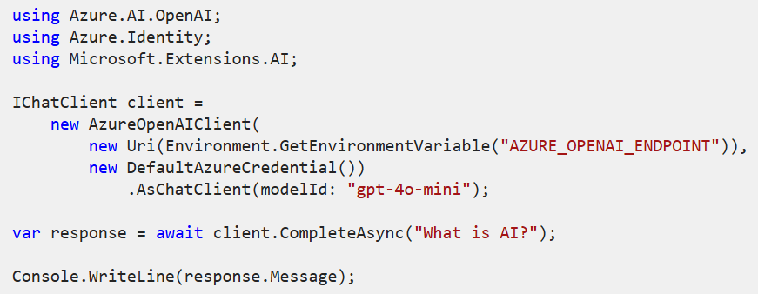
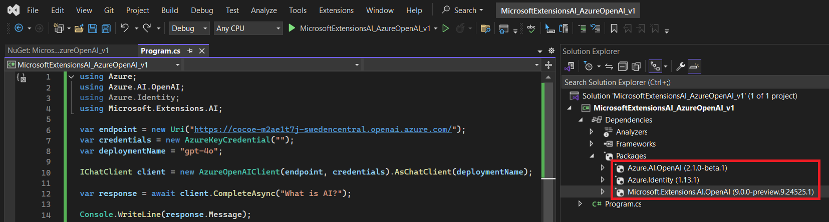
Microsoft.Extensions.AI: Azure OpenAI
Install the Microsoft.Extensions.AI.OpenAI, Azure.AI.OpenAI, and Azure.Identity NuGet packages
https://github.com/luiscoco/microsoft-extensions-ai-AzureOpenAI

Slide 36
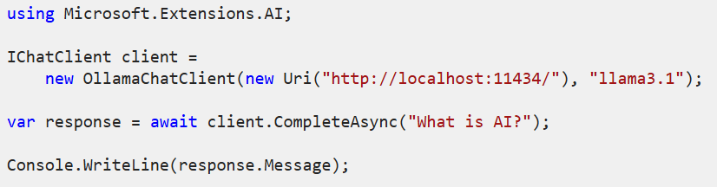
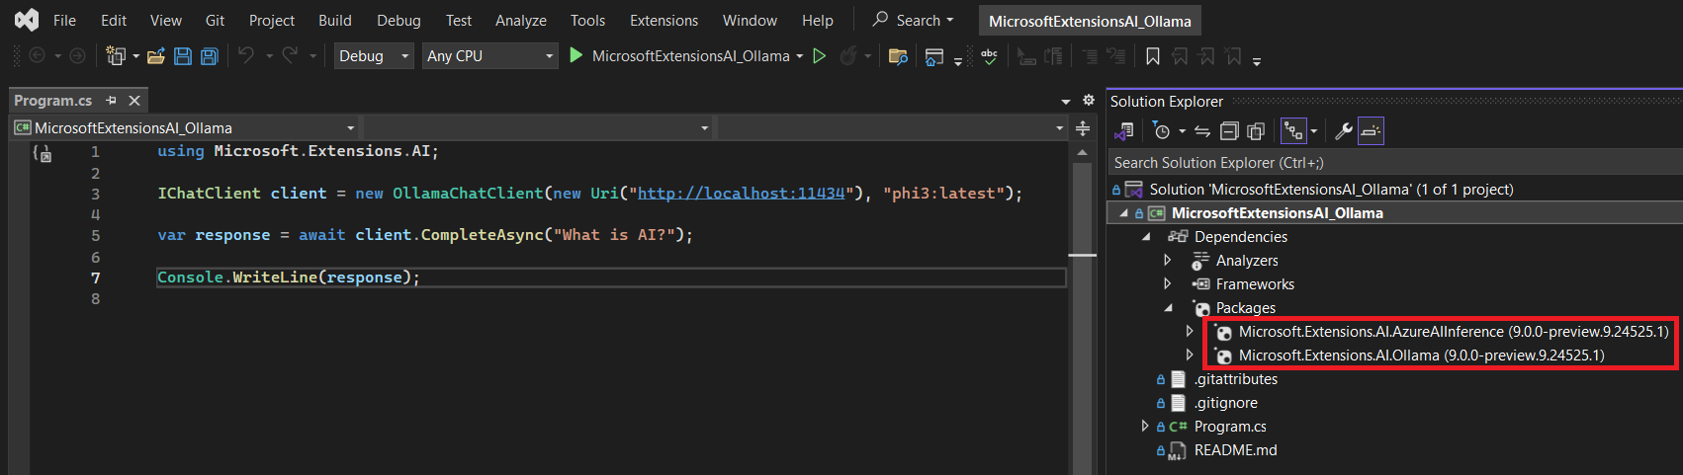
Microsoft.Extensions.AI: Ollama
Install the Microsoft.Extensions.AI.Ollama NuGet package
https://github.com/luiscoco/microsoft-extensions-ai-Ollama

Slide 37
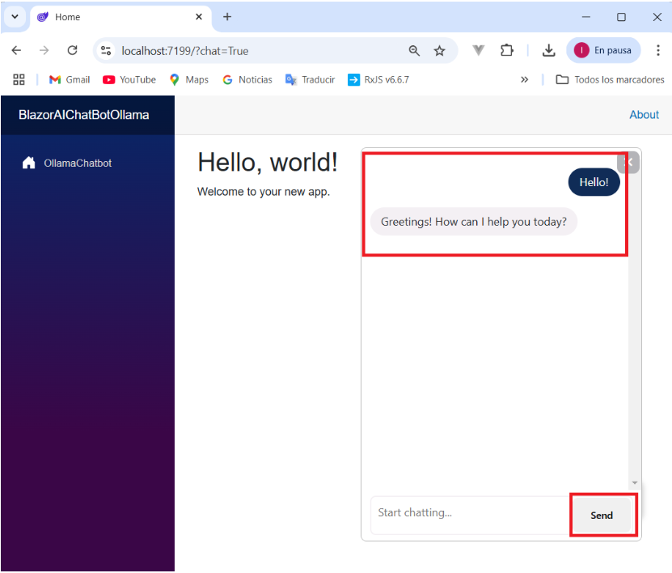

Microsoft.Extensions.AI: Blazor Web App with Ollama Chatbot
https://github.com/luiscoco/microsoft-extensions-ai-sample-BlazorAIChatBot_with_Ollama

Slide 38


RAG (Retrieval Augmented Generation)
RAG is an AI technique that combines retrieval-based and generative models to improve information relevance and accuracy in responses. In RAG, a retrieval model first searches a large database or set of documents to find relevant information based on the user's query. Then, a generative model (like GPT) uses the retrieved information to produce a coherent, context-aware response. This approach helps the AI provide responses that are both accurate and grounded in relevant data sources, making it particularly useful for tasks requiring specific or factual information.
Efficiently Searching PDF Content with AI: Leveraging LLMs and RAG for Enhanced Retrieval
https://github.com/microsoft/AzureDataRetrievalAugmentedGenerationSamples

Slide 39

eShopsupport
Youtube video
https://github.com/dotnet/eShopSupport
https://github.com/luiscoco/Curso_Aprende_Blazor-Nivel_Intermedio-AI_eShopSupport-Assistant_Fixed-With-Azure_OpenAI
https://github.com/luiscoco/Curso_Aprende_Blazor-Nivel_Intermedio-AI_DataGenerator

